Slide 1

POC - Asset Management Portal
Mentees : Janhavi Borde , Karan Gadodia, Kumar Nayan , Nayan Varma, Niraj Gangwani
Mentor : Manoshri Gaykwad
Date – 27th Sept 2022

Slide 2
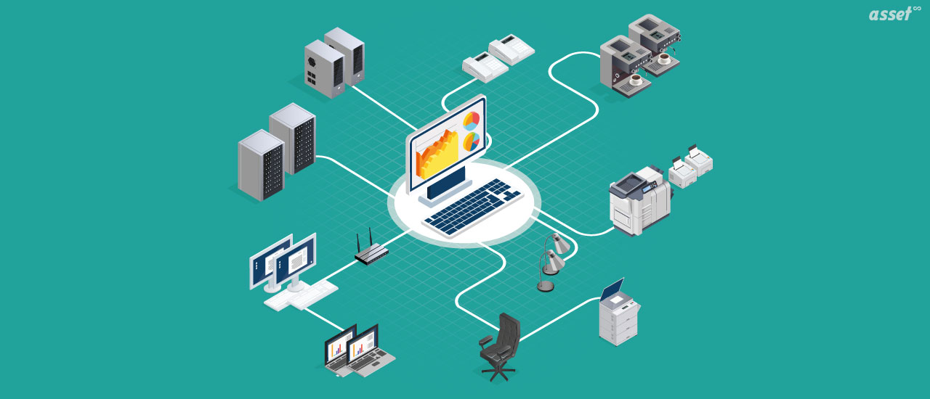
Problem Statement
Create a simple web portal to login to the home screen. Admin can Add, edit, update and delete assert details. Store data in database. View data and review specific data by the employee.

Slide 3

Solution
Provide asset management software which allows you to easily align your hardware and asset owners.

Slide 4



Technologies used
Backend : Spring Boot
Front end : React JS
Database : MySQL

Slide 5
Wireframe, API Documentation​ ​
Wireframe
API documentation

Slide 6
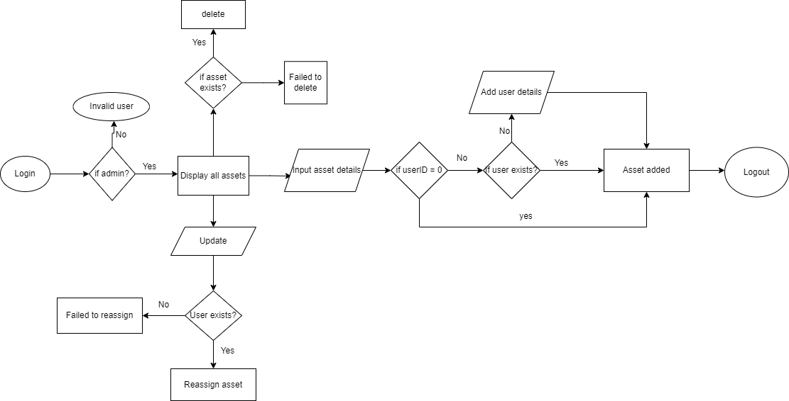
Flow diagram (Admin)
no

Slide 7
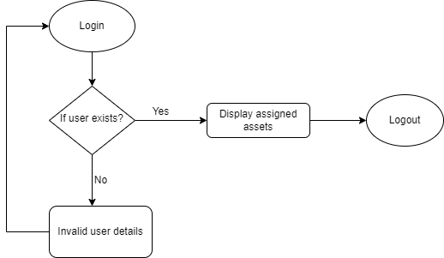
Flow diagram(User)

Slide 8
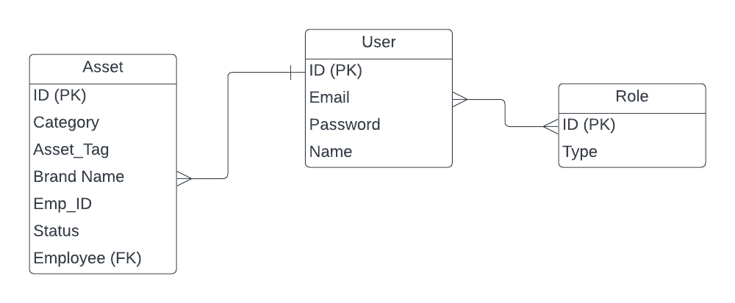
Class Diagram

Slide 9
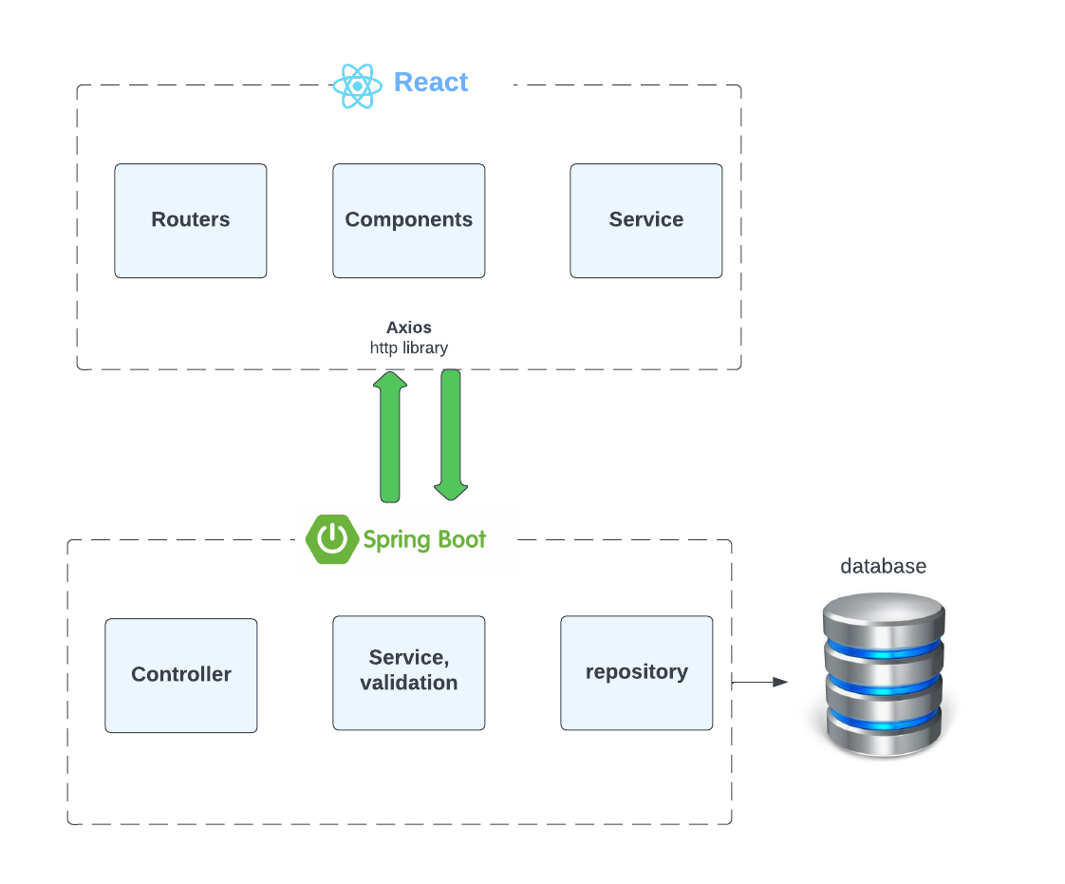
Architecture diagram

Slide 10
Demo
Launch Application

Slide 11
Questions?

